Slide 1

Graphic Novels in Libraries: Not Just For Kids Anymore
Or, How I Got My Library to Feed My Habit…
Presented by Lisa Prolman
Assistant Director, Greenfield Public Library
October 1, 2009

Slide 2
What is the difference between a comic book and a Graphic Novel?
Comic books
  Shorter
  paperback
  generally don’t tell a whole story in one issue.
  published monthly
Graphic Novels
  can be hardcover or paperback
  tell a whole story between the covers
  can be stand-alone stories or a collection of several comic books making one story or arc

Slide 3
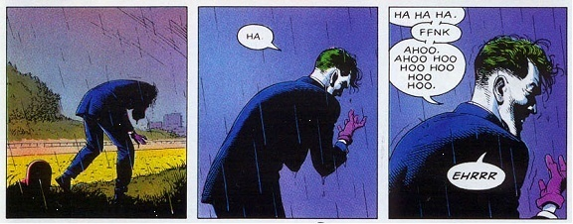
Q: How do you read a Graphic Novel?
A: Panel Transitions
Scott McLeod’s Making Comics describes five different transition types.
Moment-to-Moment
In which a single action is portrayed in a series of movements and the narrative slows down and admits more detail.
Images from The Killing Joke by Alan Moore (writer) and Brian Bolland (artist).

Slide 4
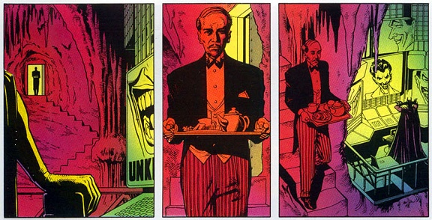
Action-to-Action
In which a single subject (person or object) performs a series of discreet actions.

Slide 5
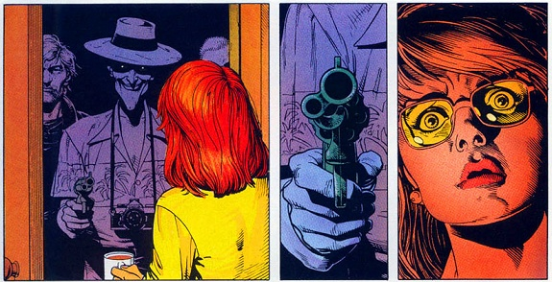
Subject-to-Subject
In which a series of changing subjects (persons or objects) are depicted within a single scene.

Slide 6
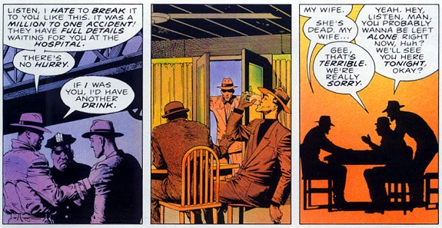
Scene-to-Scene
In which transitions move across significant distances of time or space.

Slide 7
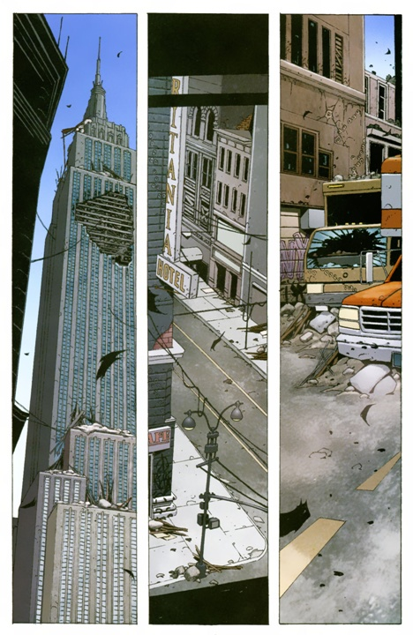
Aspect-to-Aspect
In which time stands still and the scenes "transition" by showing different aspects of the same place or mood.
(Final image from DMZ by Brian Wood)

Slide 8
Types of Graphic Novel
Traditional superhero: Batman, Superman, X-Men, Spider-Man (notice a trend?), Birds of Prey, Exiles, Wonder Woman
Non-fiction: Persepolis, Pedro and Me, Palestine, Treasury of Victorian Murder, Blankets
Literary: Jane Erye, Shakespeare, Age of Bronze (Trojan War), Beowulf
Television/Movie Tie-ins: Buffy/Angel, Heroes, Star Wars, Star Trek
Original Stories: The PLAIN Janes, Hopeless Savages, Boneyard, Fables, and many more.

Slide 9
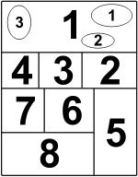
What’s Manga?
The short definition: Manga is a style of cartoons and comic books from Japan.
The long definition can be found on Wikipedia: http://en.wikipedia.org/wiki/Manga.
Traditional manga is read right to left rather than left to right as shown:
Notes:
Manhwa – Korean, Manhua – Chinese

Slide 10

Common Manga Genres
Shojo:
  “Comics for Girls”
  generally feature pretty characters – both boys and girls – with large eyes
  idealized romances
  many subgenres.

Slide 11

Shonen:
  “Comics for Boys”
  tend to have more action and humor
  competitive sports or fight squads are popular
  some female characters can have exaggerated endowments.

Slide 12
Josei:
  aimed at older teen girls and women
  often are about women’s everyday lives
  romances are more realistic than those in Shojo.
  one subset of this is yaoi or Boys’ Love (BL); mainly drawn and read by women, featuring beautiful boys in relationships; contain sex scenes – generally not explicit – and sexual themes.
Seinen:
  aimed at older teen boys and men
  defined as having “a wide variety of art styles and more variation in subject matter, ranging from the avant-garde to the pornographic.” (Wikipedia)
  one subset is hentai – this is sexually explicit.

Slide 13
Resources to Build a Collection
GN-LIB (Graphic Novels in Libraries) listserv http://groups.yahoo.com/group/GNLIB-L/
VOYA’s “Graphically Speaking” by Kat Kan
Library Journal Reviews
Steven Wiener’s The 101 Best Graphic Novels (2005).
Manga Blog: http://www.mangablog.net/
Notes:
Steven is the director of the Maynard Public Library.

Slide 14
Gilles Poitras’s The Librarian’s Guide to Anime and Manga; also http://www.koyagi.com/
Robin Brenner’s Understanding Manga and Anime; also http://noflyingnotights.com
http://mangaworthreading.com/
Diamond Comics Bookshelf (information/reviews) http://www.diamondbookshelf.com/public/
Your local comic book store
Your patrons!
Notes:
Robin is the Teen Librarian at the Brookline Public Library; NFNT hasn’t been updated in a while but still has great reviews.

Slide 15
Collection Development Sources from Jobbers
https://ipage.ingrambook.com/ipage/mp002.jsp?contentId=449608 (Ingram)
http://tsprod3.btol.com/Titlesource/TitleSource.asp (B&T)
http://www.bwibooks.com/start.php?target=%2Fsptopics2.php%3Fcore%3D3871 (BWI)

